Slide 1
Discussion Questions
What are the critical differences between Connell and MacArthur’s studies?
Could Connell have measured competitive intensity, importance, or both? Explain.
What do you think “the ghost of competition past” means, and how might it relate to MacArthur’s study?

Slide 2
Competition
Community Ecology Week 1

Slide 3
Definition (my favorite, anyway)
“The induction of strain in one organism as a result of the use, defense, or sequestering of resource items by another organism ” (Welden and Slauson 1986)

Slide 4
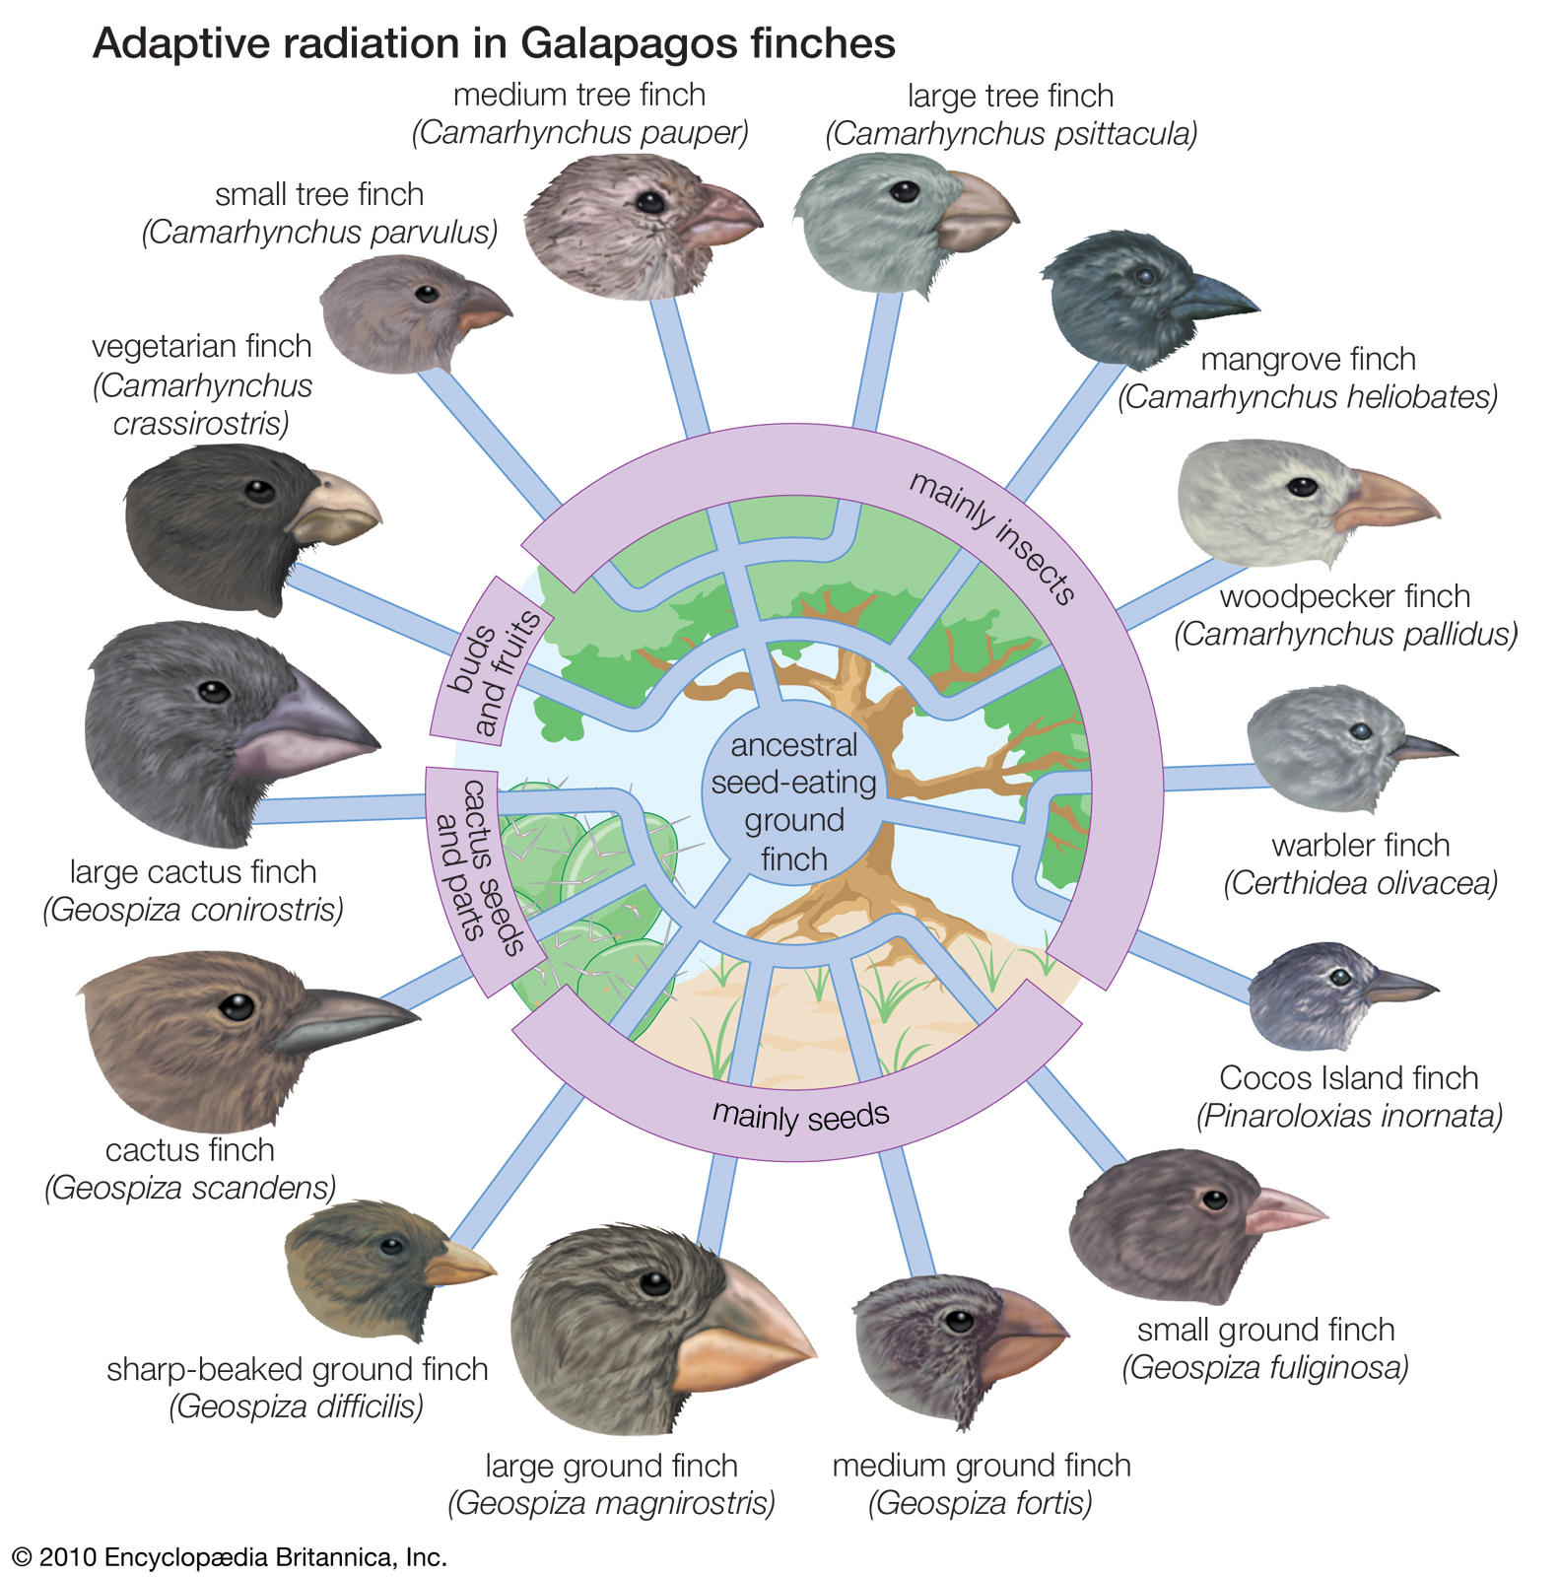
Evolutionary Perspective
Competition drives niche differentiation

Slide 5
Connell’s “Ghost of Competition Past”
Niche differentiation may be a consequence of past competition (Connell 1980)
Are we seeing differences in the fundamental or realized niches?
Fundamental: Set of environmental and resource conditions that permit non-negative population growth
Realized: The subset of the fundamental niche that is occupied following effects of competition, predation, disease, etc.

Slide 6
Coexistence Scenarios
Differences in fundamental niches:
Niche partitioning is the result of past competition, where species with too much overlap with others have been excluded
Differences in realized niches:
Species are actively competing and are restricted to those sets of micro-environments or resources that they can best compete for

Slide 7
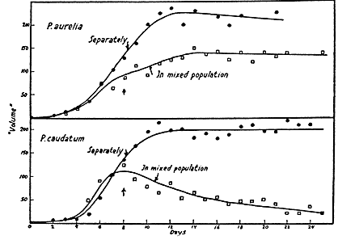
Early Models
Gause’s Law: species
with the same niche
cannot coexist at
equilibrium
Lotka-Volterra model:
intraspecific competition
> interspecific
Gause 1934
MacArthur 1958 Ecology

Slide 8
Niche Differentiation → Coexistence
In space
MacArthur’s warblers (feeding position)
Connell’s barnacles
In time
MacArthur’s warblers (nesting)
Summer vs. winter active plants
Or…

Slide 9
In Requirements for Different Resources
Resource ratio theory of coexistence (Tilman 1977; 1985)
Species differ in relative limitation by 2+ factors (e.g. light, nitrogen, water, etc.)
Ratio of resource supply rates determines which species co-occur
Theoretically infinite number of species can coexist
Tilman 1985 Ecology

Slide 10
Tradeoffs
Why should we expect variation in species requirements for different resources or tolerances of different stressors?

Slide 11
Examples of Tradeoffs
Competition/colonization (Tilman 1994)
Growth rate/longevity (Stearns 1977)
Growth rate/efficiency (Wright et al. 2004)
Efficiency/safety (Tyree et al. 1994)
And on and on and on

Slide 12
Tradeoffs and Functional Strategies
Grime’s competitor – stress-tolerator – ruderal (CSR) strategy scheme
Tradeoffs in performance
along axes of disturbance
and stress
R
Rapid growth, allocation to reproduction
Disturbance
S
Slow growth, tolerant of low resources or high stress (e.g. frost)
C
Rapid growth, high resource uptake and allocation to acquisition
Stress
after Grime 1977 AmNat

Slide 13
The Great Grime/Tilman Debate
Issue | Grime | Tilman | Resolution(?)
What constitutes competitive superiority | High resource uptake capacity | Lowest equilibrium resource requirement | Depends on resource availability: Tradeoff between resource capture capacity and tolerance of low resource levels (explicit in Grime’s model, implicit in Tilman’s)
Competition for multiple resources | Positively correlated | Negatively correlated | The jury is out…
Environmental context-dependence of competition | Less intense in unproductive habitats | May be equally intense in all habitats | Intensity vs. importance: Grime considers tradeoffs in importance of competition and stress; Tilman’s model does not incorporate importance, only intensity
Successional context-dependence of competition | Competitors dominate during mid-succession | Determines dominance during all phases | Grime supported: Competition not so important in early stages, tolerance of low resource levels more important at later stages of succession
after Grace 1991 Func. Ecol.

Slide 14
Intensity vs. Importance
Optimal conditions
Competition only
Competition + environmental stress
Intensity
Absolute effect
Importance
Effect relative to all other factors that can reduce performance
Competitive Intensity is the Same (18)
Competitive Importance is Different (18/24=0.75; 18/36=0.5)
Brooker et al. 2005 Oikos

